Slide 1
Social Buzz
Social Media & Content Creation Company

Slide 2
Today’s Agenda :
Project Recap
Problem
The Analytics Team
Process
Insights
Summary

Slide 3
Project Recap
Social Buzz is a Social Media & Content Creation Company established in 2010 in San Francisco.
Over the past 5 years, Social Buzz has reached over 500 million active users each month.
Every day over 100,000 pieces of content, ranging from text, images, videos and GIFs are posted.
We, Accenture have embarked on a 3 month pilot with Social Buzz to focus on 3 main tasks.
Firstly, we will be doing an audit of your big data practice.
Guiding you through a successful IPO.
Conducted an analysis of your data to find insights regarding your top 5 most popular categories of content.

Slide 4
Problem
Social Buzz is rapidly growing and their core product is of digital nature.
All of this data is highly unstructured and requires extremely sophisticated and expensive technology to manage and maintain.
Clearly with such grand scale of data comes challenges.
The real value is in understanding and crunching this content to gain a deeper understanding of your audience and to therefore provide a more personalized and enjoyable experience.
Social Buzz is still a small company and do not have the resources to manage the scale that they are currently at.
So, they are keen on understanding how the world's biggest companies manage the challenges of big data.
This is where out data analytics expertise comes in, with the insights that we've uncovered from this task, we can show you exactly how to take analytics to production at scale.

Slide 5
The Analytics Team
We have a team of 3 people primarily focusing on this task.
Andrew Fleming - Chief Technical Architect.
Marcus Rompton - Senior data expert.
Akshay Paunikar – Data Analyst.

Slide 6
Process
We approached and solved the problem in 5 steps.
Data Understanding.
Data Extraction.
Data Processing.
Data Visualization.
Recommendation.

Slide 7
Insights
After cleaning and processing data, we made following observations.
1000 unique content which includes photos, videos, audio and gif.
446 unique User ID’s were part of this study and analysis of Content.
16 unique Category of Content.
16 unique type of Reaction on the Content.
11676 Video, 11649 Photo, 10980 GIF and 10501 Audio reactions on the Content.

Slide 8
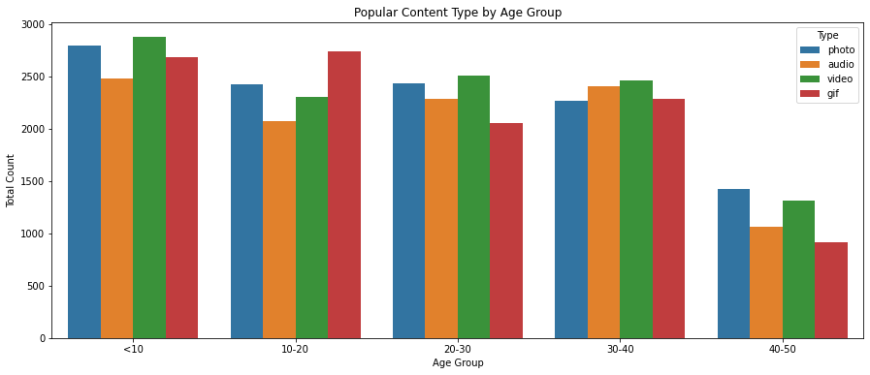
Popular Content by Age Group
For the Age Group : 30-40, each Content Type is nearly equally popular.
The Content Type : gif is more popular among Age Group : 10-20.
The Content Type : audio is less popular among Age Group : <10 than rest of the other Content Type.
The Content Type : gif is less popular among Age Group : 20-30 than rest of the other Content Type.
The Content Type : photo and video are more popular among the Age Group : 40-50 than rest of the other Content Type.
Overall, video and photo are most popular Content Type.

Slide 9
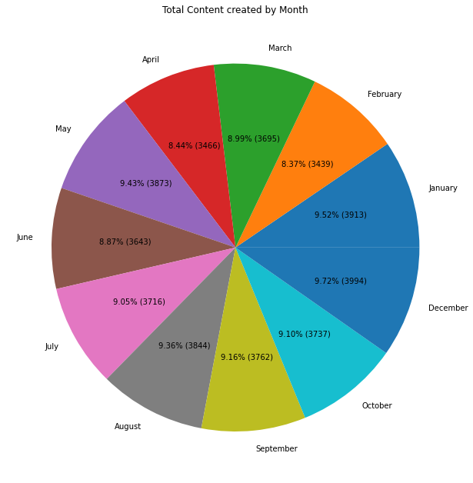
Total Content Created by Month
The Month : December, January and May saw maximum content posted.
The Month : June, April and February saw minimum content posted.

Slide 10
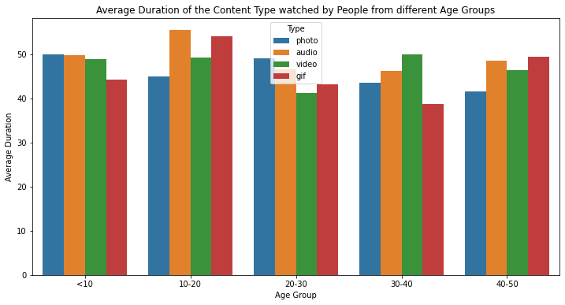
Average Duration of the Content
Age Group <10 spend more time watching Content Type : photo, video, audio.
Age Group 10-20 and 40-50 spend more time watching Content Type : audio, gif.
Age Group 20-30 spend more time watching Content Type : photo, audio.
Age Group 30-40 spend more time watching Content Type : video.

Slide 11
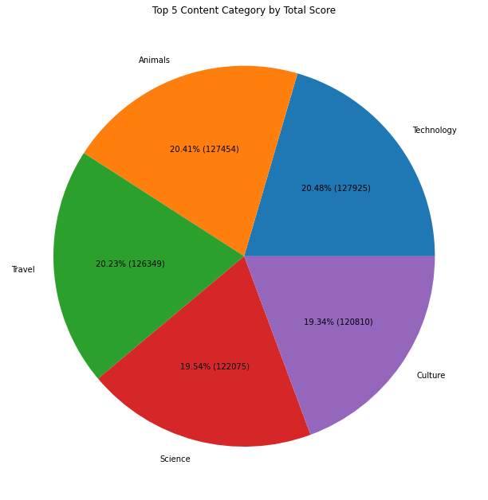
Top 5 Content Category by Score
Among all the 16 Categories of Content, the top 5 categories are : Technology, Animals, Travel, Science, Culture.
Technology – 127925.
Animals – 127454.
Travel – 126349.
Science – 122075.
Culture – 120810.

Slide 12
Summary
We found the Top 5 Categories popular among Users.
Also, other categories that are indirectly related should be taken into consideration.
We must post content considering the Age Groups of our Users for maximum engagement.
Keep in mind the Duration of the Content according to the People from different Age Group.
Also, we should look out for any upcoming festivals or sports tournaments which will increase our engagement.

Slide 13
Thank You !!! Any Questions ???

